Slide 1
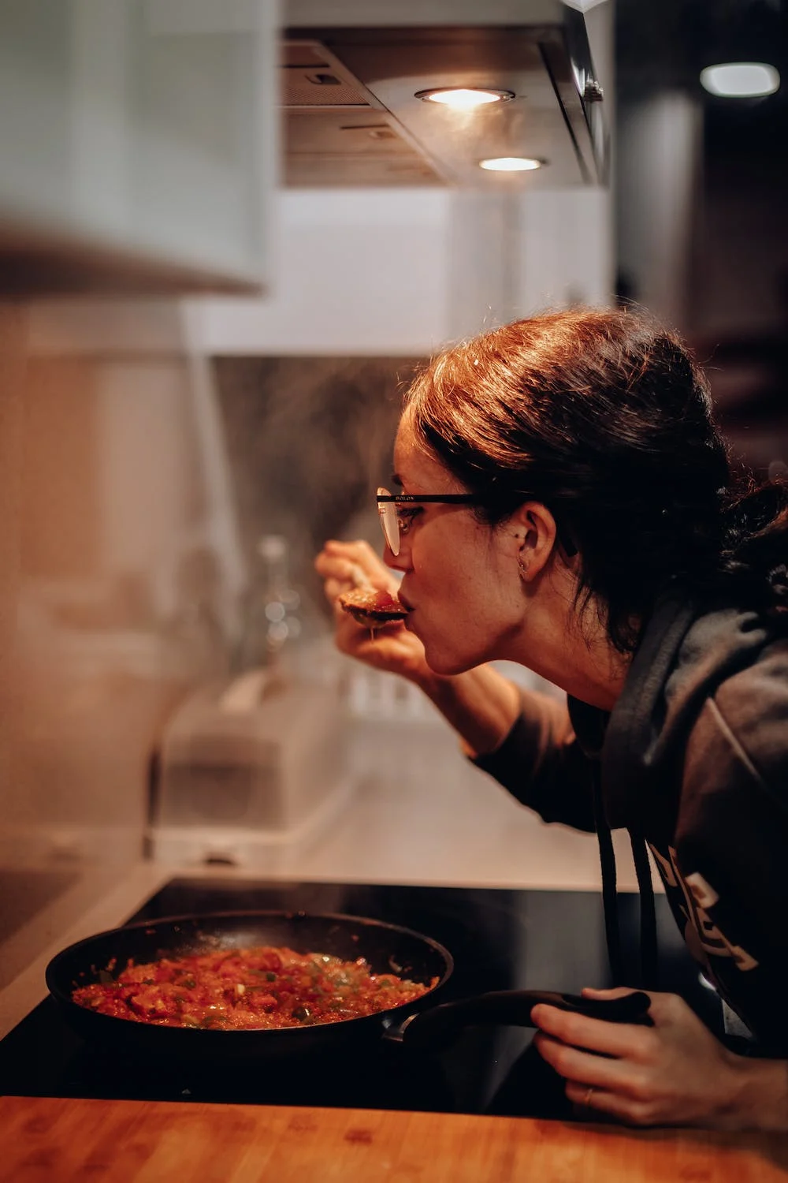

Taste of DashPass Concept Test
Kelly Peterson
Date: May 25 2023

Slide 2



Research Approach
Breakdown of Sessions
Interview Session 1:
We conducted interviews with 11 participants across 2 research sessions on 5/18 - 5/23
All Cx were located outside of initial EPIC test markets
Included a mix of occasional, habitual and churned DashPass users
Cx attended 2, 20 min sessions
Cx were shown either a Fast Food or Non-Fast Food prototype based on the ordering preferences they shared in their screener
Collect current DoorDash affordability perceptions & DashPass understanding
Asses initial understanding of the offer
Identify what Cx expect will happen in the future
Fast Food Prototype
Non-Fast Food Prototype
The goal of these calls were to…
Collect reactions to the ToDP concept
Identify areas of confusion and misunderstanding
Explore how a Cx may learn about the offer over time
Understand potential impact on DoorDash and DashPass perceptions
Interview Session 2:
Test recall and asses understanding of rotation
Identify areas of confusion, misconception and frustration
Understand impact on perceptions of DoorDash, DoorDash and DashPass
Fast Food Prototype
Non-Fast Food Prototype
The research brief can be found here.
Notes:
James to link to failed session

Slide 3
Detailed research questions
Research questions covered:
Category | Priority | Questions
Rotation | P0 | How do Cx feel about the rotation of restaurants? How long should an Rx be in the rotation? What feels fair? What format should be used for the rotation? How important is new vs. what is going away? What do they think they would do if a preferred Rx rotates out? What categorization of Rx would they want to see in the rotation?
Interest & Clarity | P0 | Do Cx care about the Taste of DashPass offering? Is it exciting? Do Cx understand the Taste of DashPass offering? Do they understand all of the steps? To what level should they be broken out/not broken out? What limitations do Cx feel exist? Where might there be areas of confusion? Where would Cx go to try to find more information?
DashPass | P1 | Does the connection to DashPass make sense? Does it feel differentiated from DashPass content they see today (trial, upsell)? Do Cx understand that Taste of DashPass is free, and they sign up as a preview? How might Taste of DashPass change their view of DashPass? How might understanding of the rotation impact DashPass sign ups?

Slide 4
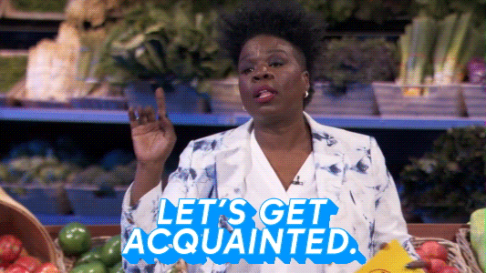
First Visit:
Initial Introduction

Slide 5
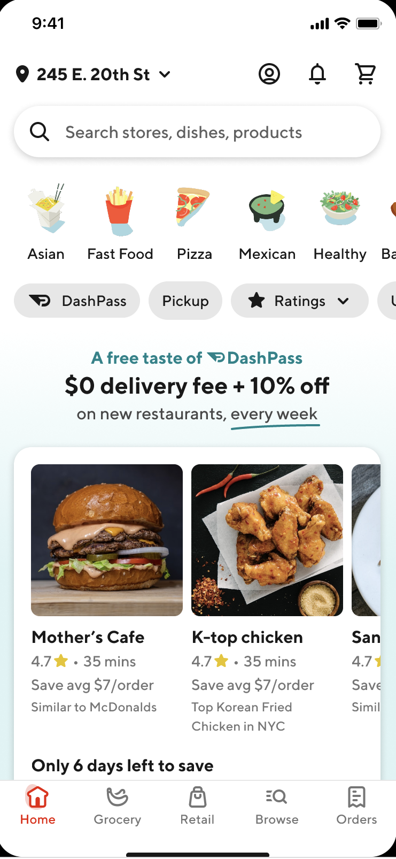
Most Cx miss “Taste of DashPass” at first glance at the homepage
Most Cx scrolled right past and indicated that was an ad for DashPass and they see them a lot. There was the general sentiment that this is what you “would” get with DashPass
2 out of 11 Cx scrolled back to the top after looking through the homepage, they thought that this meant there was a 10% off discount for restaurants that were new on DoorDash
The “only 6 days left” to save category caught the eye of some Cx, they assumed it was a collection of Rx that have promotions that are expiring soon

Slide 6

DashPass fatigue causes confusion for most of the journey
Cx reactions to initial homepage and store page:
“I think this is maybe a free trial of dashpass for a week, probably one week.”
“I don’t pay much attention to DashPass because of where I moved and I don’t order enough”
“This is showing it to me as if I had DashPass”
There it says there is a trial of DashPass, I see that everywhere in the app. I see the DashPass symbol, I’m familiar with it.
“Did I sign up for a trial of DashPass I didn't want to do that? I'm getting something I didn't know I was supposed to be getting.”
We should consider excluding DashPass from at least the initial introductions to the offer, otherwise we risk Cx ignoring it all together. UXR recommends A/B testing a branded and unbranded version.

Slide 7
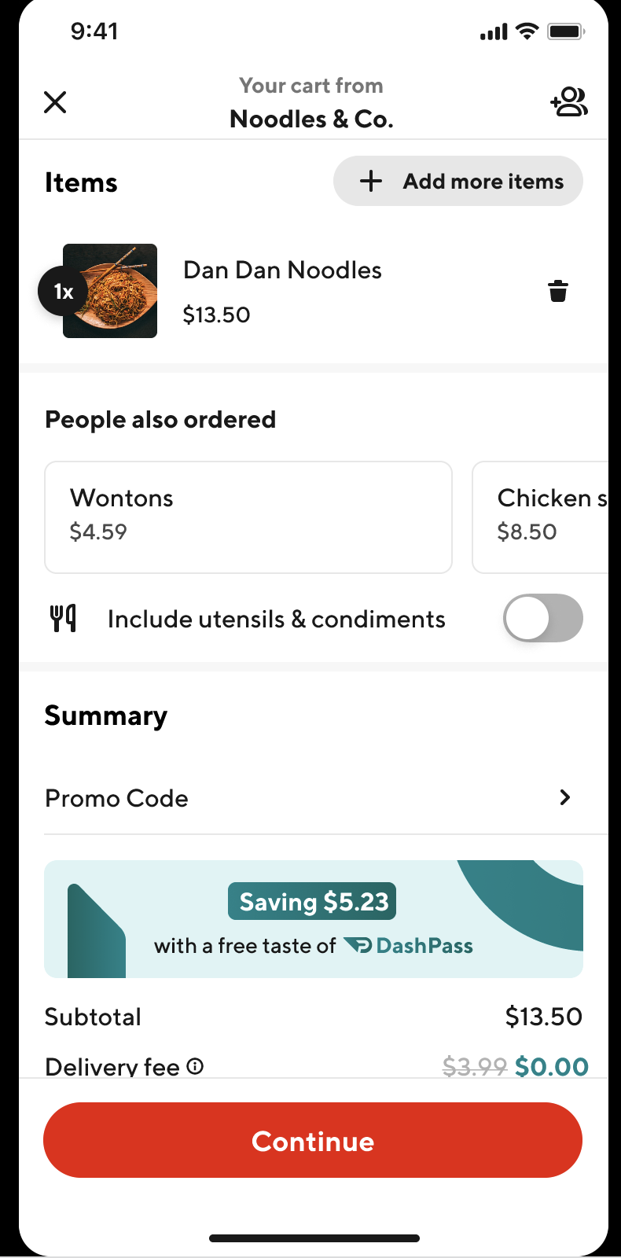
Cx noticed the banner at checkout clearly, though interpretation of that banner was mixed
Cx reactions:
I have or need DashPass |  | I received savings
This is telling me how much I would save if I had DashPass | Did I sign up for a DashPass trial? | It looks like a promo was maybe applied | I’m saving because of taste of DashPass
3 out of 11 Cx | 4 out of 11 Cx | 2 out of 11 Cx | 1 out of 11 Cx
The look and feel of the savings announcement feels too much like a banner ad for DashPass. Additionally the connection to “taste of” is getting lost and needs to be more prominent

Slide 8


There were greater Cx reactions to the 10% than $0 delivery
Initially, Cx found the 10% to be exciting
Cx who thought that this was an ad for DashPass thought that 10% off for non-DP Cx
3 Cx interviewed had DashPass previously and thought this was an extra promotion on top of what you typically get with DashPass
However, Cx became skeptical when they couldn’t clearly find it at checkout
Cx expect the 10% to come off of the total amount
Cx that had DashPass in the past were the most confused about where the 10% is
Generally, Cx said that they would trust it was reduced, but they were off put by it not being very clear

Slide 9
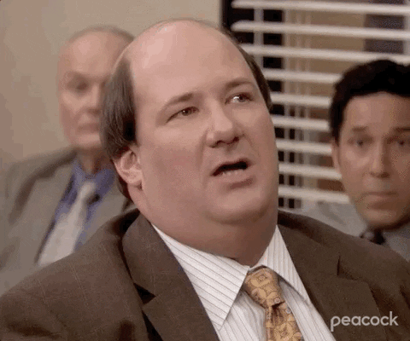
At the end of the visit, Cx felt slightly confused but mostly unphased

Slide 10

Next Visit:
Introduction of Rotation

Slide 11
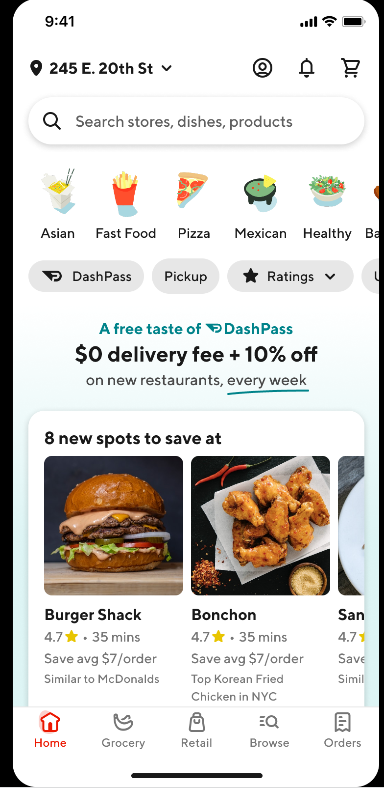
In their second visit, more Cx noticed ToDP on the homepage
Once returning to the app, 8 out of the 11 Cx noticed the $0 delivery + 10% off at the top of the screen.
6 of these Cx acknowledge “Taste of DashPass”, though half found it confusing and still were unsure if it was a trial that you had to sign up for
There were still a few areas of confusion:
Some Cx thought it was a DashPass trial that required sign up
Some Cx thought “new” meant “new to doordash”
Some Cx didn’t understand that the carousel below was the Taste of DashPass

Slide 12

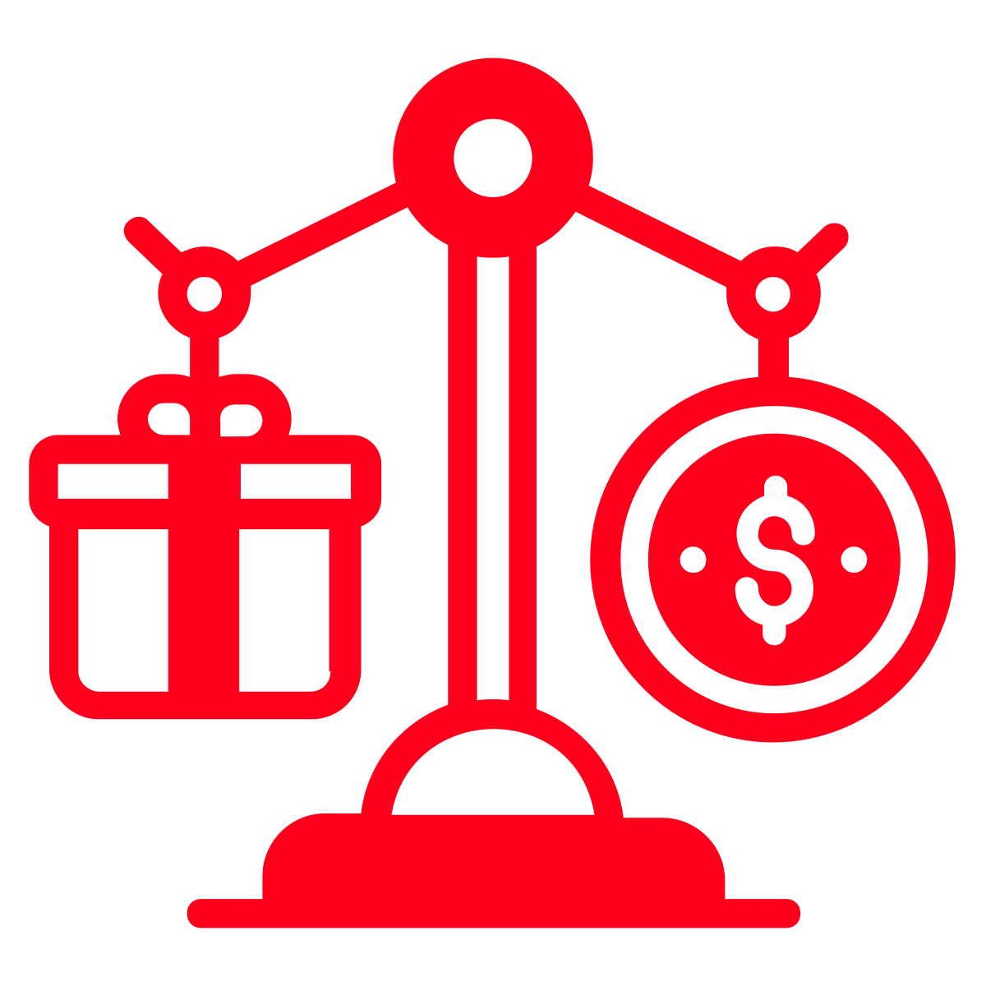

Cx expected actions to ToDP align to ordering preferences
Cx who like to try new things are likely to look for ToDP Rx and try new places
Cx who exclusively order from the same Rx will comparison shop or order anyway
Cx consider the following when ordering from a new Rx:
Ratings/reviews (4.5 and above)
Needs to have a strong # of ratings
It is recommended by others/I’ve seen it outside of DoorDash
It will not take too long
The menu has the item I want
The prices seem fair
The pictures of the food look good
These Cx primarily included those that selected fast food as one of their more frequently ordered Rx on DoorDash. This should be explored further and validated using behavioral data.

Slide 13
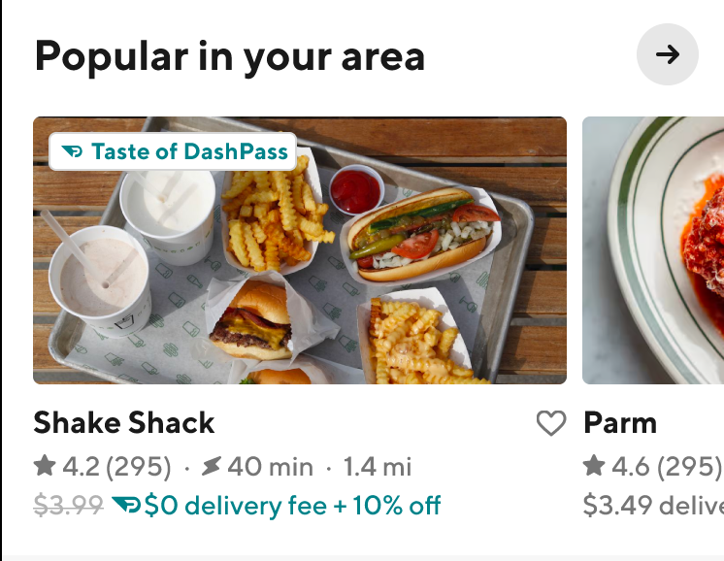
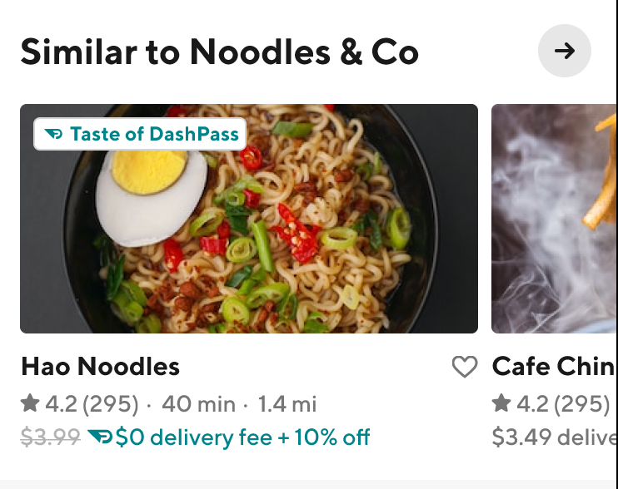
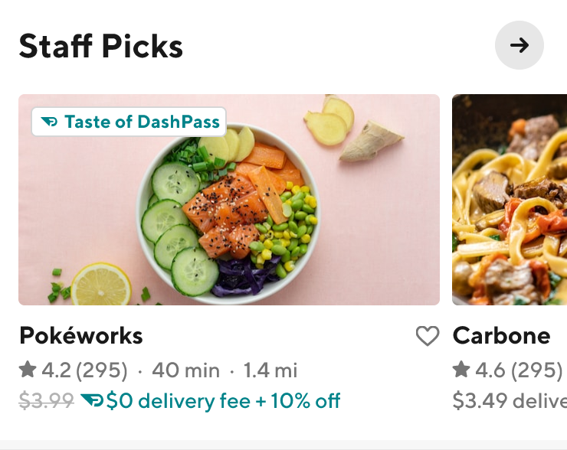


Cx found “popular in your area” and “similar to” helpful; they did not like “staff picks”

Slide 14
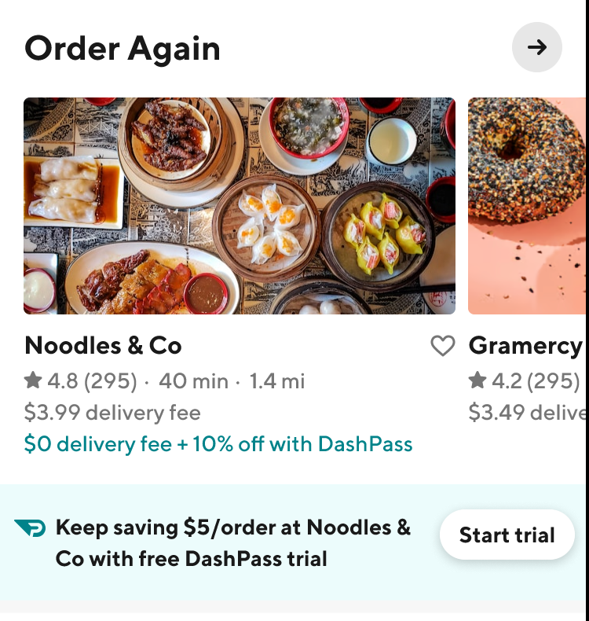
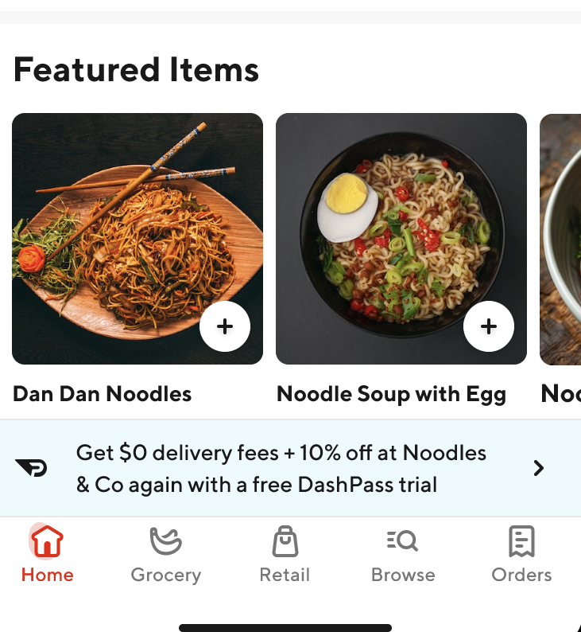
DashPass upsells early in the flow were a bit confusing for Cx
Cx found the store cell upsell confusing:
The teal text feels like they are getting savings, but they are also being told to get a trial
Cx aren’t sure why they should “keep” saving or where the $5 came from
Many Cx assumed it was a one week trial
Cx ignored this upsell on the store page:
It felt like the typical upsell that they see and did not feel special or personalized to them
Many Cx assumed it was a one week trial

Slide 15
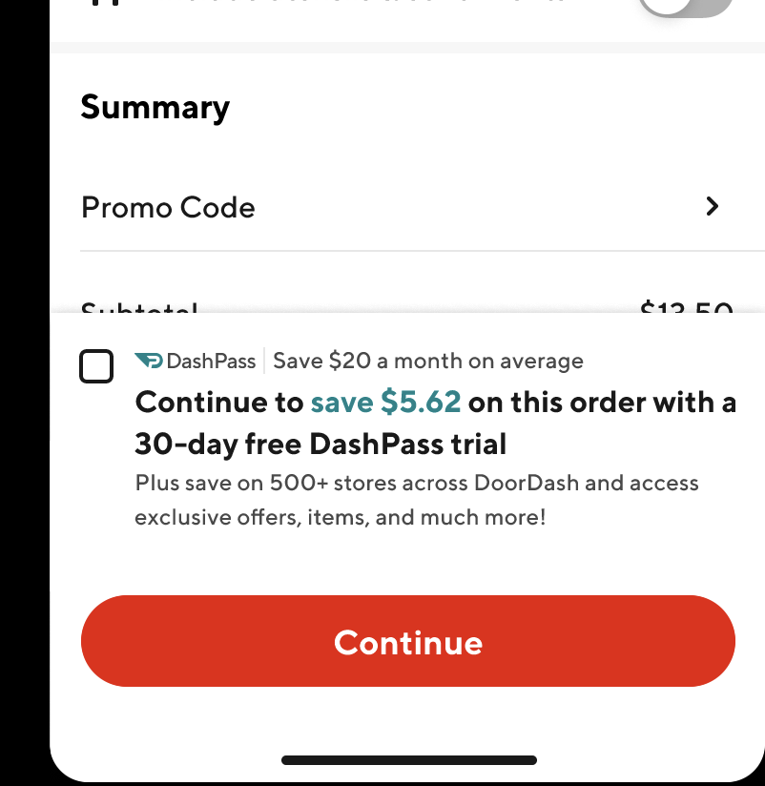
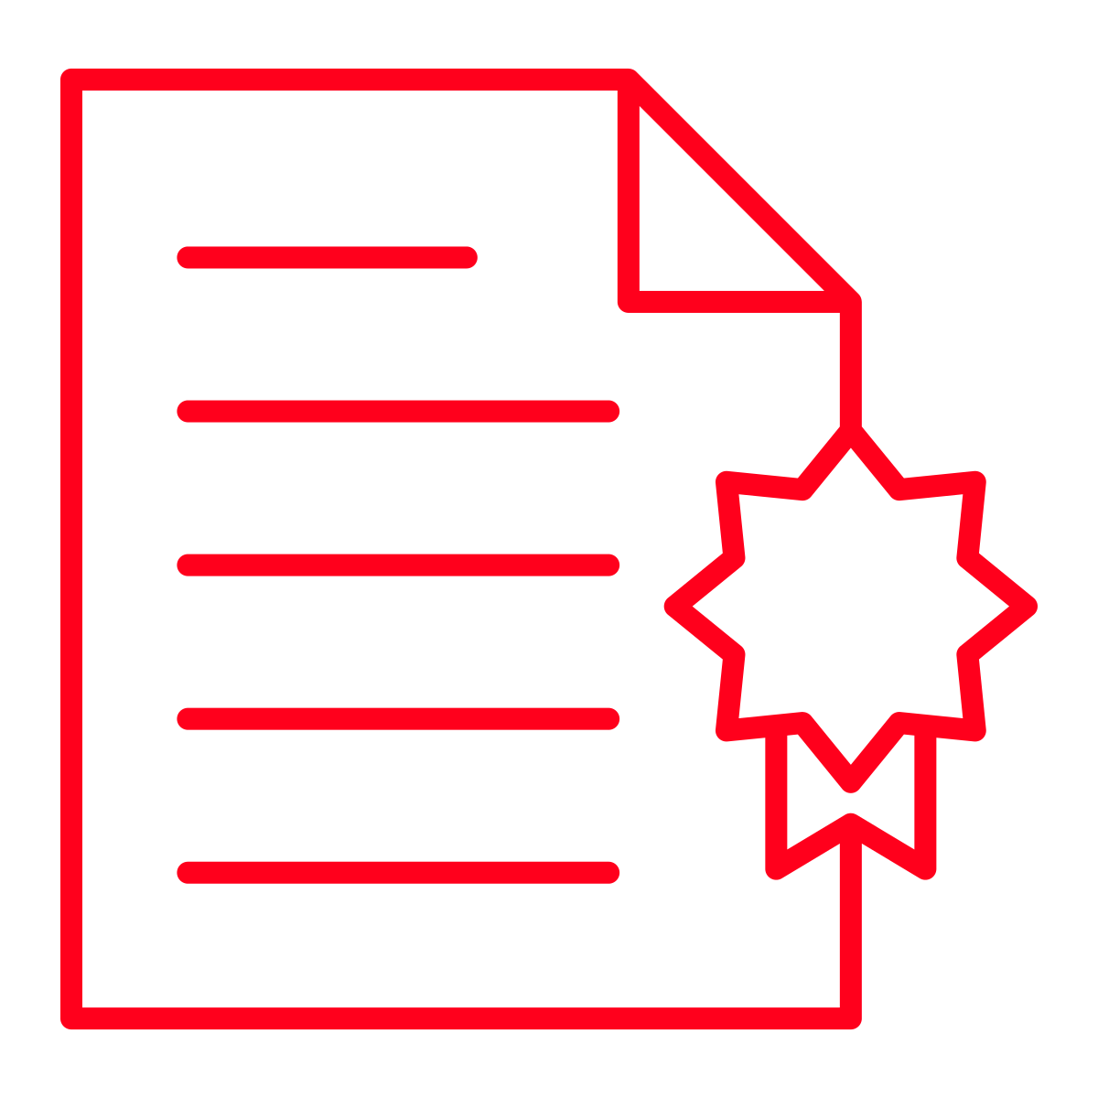


Cx prefer to see the upsell at checkout; they find it the most helpful
Cx appreciate:
Seeing the trial is 30 days
Seeing the exact savings to expect
Cx were frustrated by:
Inability to see their cart and contextualize the $5.62 in their order
Difficulty figuring out how to get out of this screen (they were looking for an x)
Churned DashPass Cx felt that if savings were reinforced and the tally continued with each order it would make them likely to re-sign-up for DashPass

Slide 16


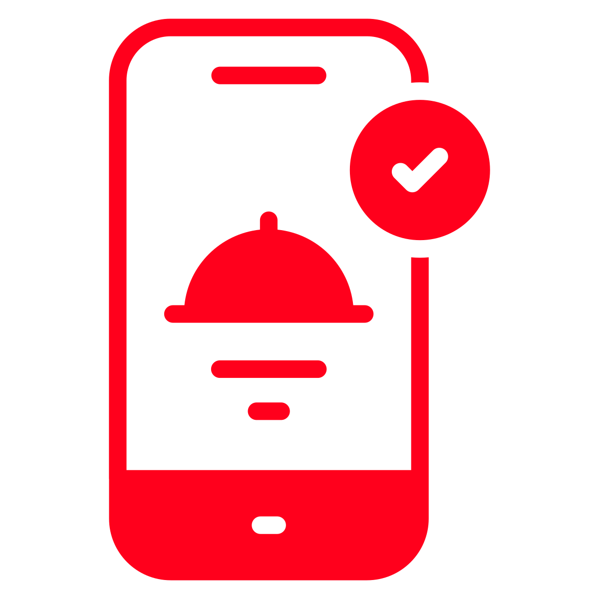

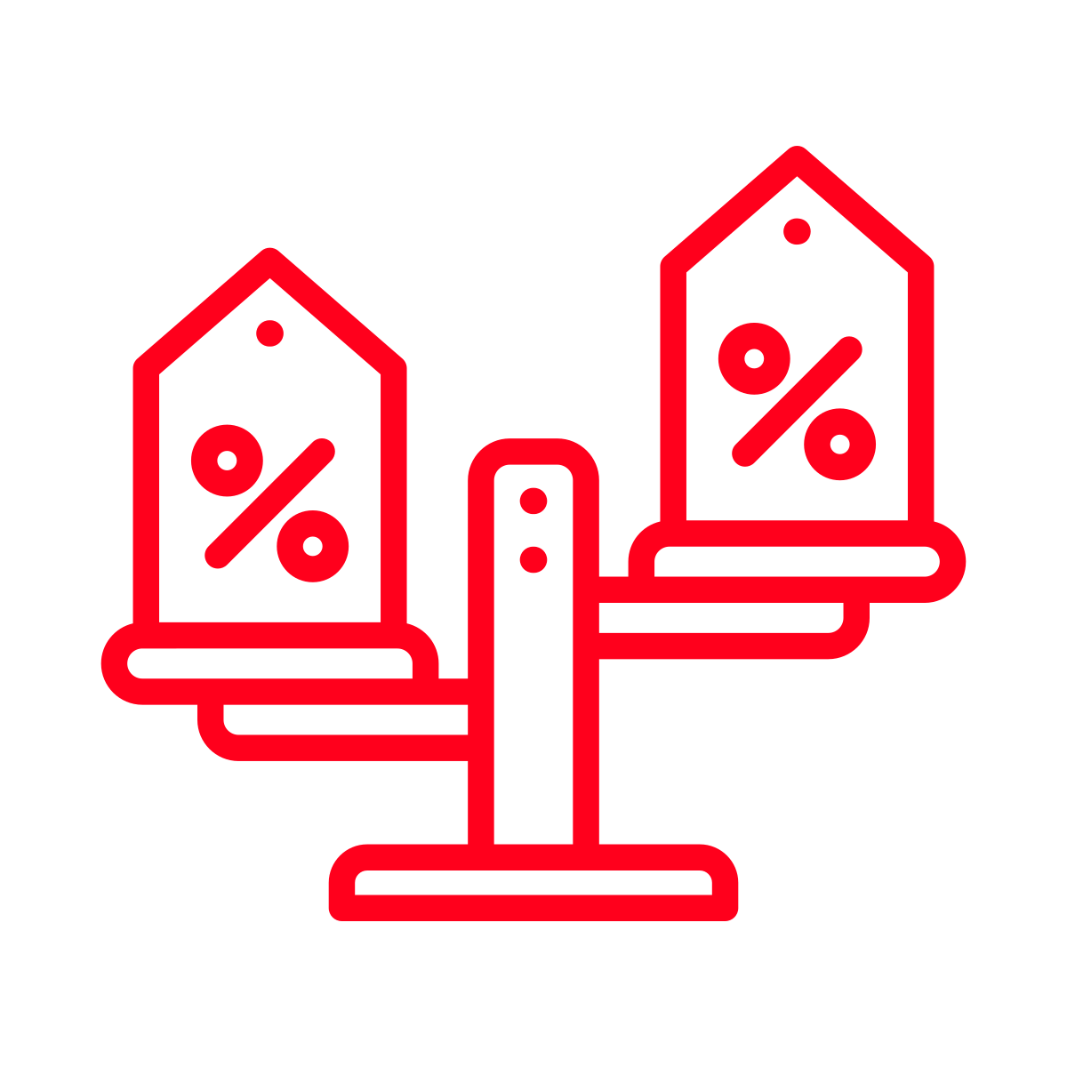
“Taste of DashPass” increased positive perceptions of DoorDash, but Cx felt mostly neutral about DashPass
7 out of 11 Cx indicated that “Taste of DashPass” made them feel more positive about DoorDash
5 out of 11 Cx indicated they would visit the DoorDash app more frequently
3 out of 11 Cx indicated they would order from DoorDash more frequently
2 out of 11 Cx said it would make them more strongly consider DashPass
Note both Cx are churned DashPass Cx
Additionally, 3 out of 11 Cx that comparison shop indicated they would look at DoorDash first when shopping for food

Slide 17


A few ideas from our Cx…
Provide more information
Create more excitement
Only provide information at/after checkout, before then I don’t care
Have a dedicated place where I can go to learn about Taste of DashPass
Add time limitation (if I can only use it once per week I will check it once per week)
Make it feel like an event launch
Make it a rotation of selection (e.g. this week Pizza, next week Tacos) to make me want to see what the selection is each week

Slide 18

Cx use DoorDash and DashPass interchangeably throughout both interview sessions
“
I used to have DoorPass but I cancelled it because I am not ordering as much as I used to
“
“I would consider ordering from Taste of DoorDash”
“
“I will look at prices on GrubHub but I prefer to order on DashPass if I can”

Slide 19
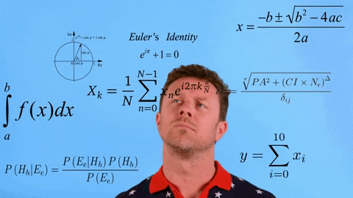
Final thoughts and recommendations

Slide 20
Summary of insights
DashPass fatigue is real. Cx are likely to scroll by initial homepage announcements and store page information as they assume it is the DashPass trial content they see throughout the app. Seeing the DashPass logo makes them feel like they already know what that information is. In fact, Cx tend to use the terms DoorDas and DashPass interchangeably.
Most Cx do not notice the savings opportunity until the checkout page. Some Cx are still confused by look and feel of the banner and think it is an advertisement for DashPass. Some Cx expressed this is the best place to learn about Taste of DashPass (at and after checkout).
After recognizing savings at checkout, “Taste of DashPass” is more likely to be recognized on the homepage. Cx see the 0% delivery and 10% off discount but do not understand the connection to DashPass.
Cx think 10% goes beyond typical DashPass savings. Most Cx are not aware that DashPass includes 10% off and therefore do not realize this is an example of the DashPass savings. At checkout Cx expect to see this 10% come off of their subtotal.
For Cx who like to explore, Taste of DashPass is viewed as a helpful tool to find new Rx. Cx will rely on ratings/reviews, time of delivery, availability of menu items, item prices, images. Carousels like “popular in your area” and “similar to” help Cx find new places. Cx who do not like to explore are more likely to comparison shop or just order anyway if their Rx of choice is not on Taste of DashPass.

Slide 21
What if we….
First introduced ToDP at checkout, with additional post check out education
This may mean auto applying to the first restaurant they order from during the experiment timeframe; for newer or occasional Cx this first purchase may help us ensure we have the right restaurants in the first few weeks of rotation
A/B test a branded and unbranded experience to first introduce the concept
Focused more heavily on the “urgency” aspect vs. the introduction of the product and used the number of days left to first introduce the concept
Made the experiment feel more like an event than an offer (if successful a communication that it will now be all of the time can be used)
Have somewhere to “learn more” from the start including teaser content of what is coming soon
Deducted the 10% from the subtotal at checkout instead of the service fees (for ToDP and DP Cx)
Had the checkout savings banner include “savings on your order” as well as a running tally of “overall ToDP savings” and/or “overall missed savings”

Slide 22
Thank you!

